Slide 1
WEB APPLICATION DEVELOPMENT TRAINING
JAVASCRIPT LECTURE SLIDES – CONDITIONAL STATEMENTS, FUNCTION

Slide 2
DAY 3 Outline
Conditional Statements
Function, argument and parameters
Internal and External JS

Slide 3
If -statement
Conditional statements are used to perform different actions based on different conditions.
Use if to specify a block of code to be executed, if a specified condition is true
Use else to specify a block of code to be executed, if the same condition is false
Use else if to specify a new condition to test, if the first condition is false

Slide 4
If- Statement
if (condition) {
block of code to be executed if the condition is true
}
if (hour < 18) {
greeting = "Good day";
}
if (condition) {
block of code to be executed if the condition is true
} else {
block of code to be executed if the condition is false
}
See Example of if … else in the note
Notes:
if (hour < 18) {
var greeting = "Good day";
} else {
var greeting = "Good evening";
}

Slide 5
If- else Statement
if (condition1) {
block of code to be executed if condition1 is true
} else if (condition2) {
block of code to be executed if the condition1 is false and condition2 is true
} else {
block of code to be executed if the condition1 is false and condition2 is false
}
Exercise : Using a prompt pop up, get the gender of your user and set different alerts for the diff gender. Eg if your user is female, tell her : shoes and bags are available for sale
Notes:
Introduce string methods toLowerCase() and toUpperCase()

Slide 6
Combining Multiple Conditions Using AND and OR
You can specify more than one conditions in a single IF statement or the else part as the case may be.
OR – the condition should execute if any of the condition is met
AND – all conditions must be met in order to execute
AND is represented using &&
OR is represented using ||
Best practice is to group the different parts of the conditions with ()

Slide 7
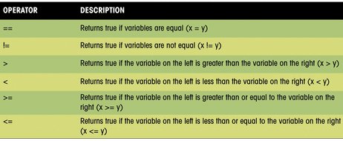
Logical Operators

Slide 8
Exercise:
In Nigeria, assume that the only eligibility condition for voting are:
  A user who is from Nigeria can vote regardless of their age
  A user must be older than 18 if he/she is not a Nigerian
Write a javascript code that accepts the age, and country of any user (using the prompt box) one after the other.
If the user is eligible to vote based on the stated condition, alert(“You can vote”)
If the user does not satisfy the eligibility condition, alert(“You cannot vote”);

Slide 9
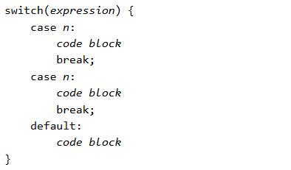
Switch statement
Used to select one of many blocks of code to be executed

Slide 10
Switch statement
The switch expression is evaluated once.
The value of the expression is compared with the values of each case.
If there is a match, the associated block of code is executed.
When JavaScript reaches a break keyword, it breaks out of the switch block.
The default keyword specifies the code to run if there is no case match
The default case does not have to be the last case in a switch block:
More than one case can share the same code block
Notes:
To share a code block among more than one case statement, just leave it empty

Slide 11
Exercise:
Building on this and on the “Show Password” button you created in previous class, use the switch statement to check the ‘type’ of the password field (document.getElementById().type) if it is currently a type “password”, change it to type “text” and vice versa.

Slide 12
Form validation
Automatic HTML Form Validation: Allows the browser to validate the form on your behalf by using the keyword “required”
Not Supported by IE 9.0 or ealier
<form action="demo.php" method="post">
<input type="text" name="fname" required>
<input type="submit" value="Submit">
</form>

Slide 13
Javascript Functions
A JavaScript function is a block of code designed to perform a particular task.
You can reuse code: Define the code once, and use it many times.
You can use the same code many times with different arguments, to produce different results.
A JavaScript function is executed when "something" invokes it (calls it). Otherwise it lies fallow forever!
A JavaScript function is defined with the function keyword, followed by a name, followed by parentheses ().

Slide 14
Assignment – Form Validation
Implement a form validation using Javascript. Your form should contain: username, password and password confirmation. Use JS to ensure that the user fills the username and uses the same password in the two password fields.
Hint: use variable to receive the form element
Use alert() to show the validation error

Slide 15
Javascript Functions
Function names can contain letters, digits, underscores, and dollar signs (same rules as variables).
The parentheses may include parameter names separated by commas:
(parameter1, parameter2, ...)
The code to be executed, by the function, is placed inside curly brackets: {}

Slide 16
Syntax of Javascript Function
function functionName(optionalParameters){
//javascript statements
}
Design and Implement the calculator shown in the next slide using JS function. Display result using alert() or otherwise
Notes:
Objective: Peer programming, use of parseInt(), understanding of Mathematical operation like modulus, function syntax, document.getElementById.

Slide 17
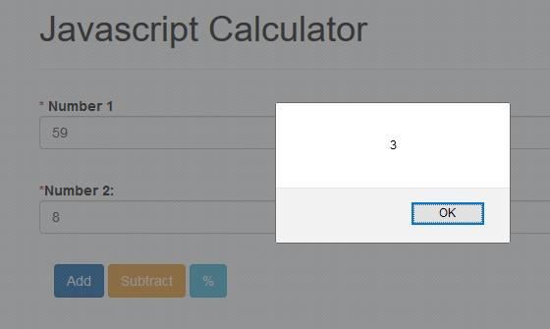

Slide 18
Function Parameters
Function parameters are the names listed in the function definition.
Function arguments are the real values received by the function when it is invoked.
Inside the function, the arguments (the parameters) behave as local variables.
The code inside the function will execute when "something" invokes (calls) the function:

Slide 19
Variable Scope
A variable declared within the script is global (available to all javascript code on that page, whether inline or internal)
A variable declared inside a function is local to that function
A variable used without being defined (use of the var keyword)is automatically treated like as a global variable : It means if you declare a variable inside a function without the var Keyword, it is automatically global(ponder: we are not just creating a new memory space)

Slide 20
Variable Scope
Local variables are destroyed when the function ends while global variables persists throughout the lifetime of the script (until the window is closed)
<head><script type=“text/javascript”>
var username = “teacher”;
</script></head>
<body>
// the variable name called username can be used here on any element
</body>
Notes:
The fact that there is the var keyword before “username” means the variable is just being created at that time and its immediately assigned a value “teacher”. - It will be seen inside body
If we omit the var keyword, it is assumed username existed somewhere and now, we are overwriting the value in it by assigning a new value called “teacher”. It will still be seen inside body
Exercise: execute alert(username) anywhere on the page, you should see “teacher”

Slide 21
Variable Scope
<head><script type=“text/javascript”>
function test(){
var username = “teacher”;
}
</script></head>
<body>
// the variable name called username is only available in the function test, it can not be used outside the function (see the notes)
</body>
Notes:
To make the variable usable outside the function, omit the var keyword.

Slide 22

Syntax of Javascript Function with Parameters
Notes:
Discuss isNaN and Ternary operator

Slide 23
Javascript Function and Return Statement
Javascript functions can return a value to the calling code when done using the ‘return’ statement
Such functions can be used as values for variables
var sum = add(6,8);
The above will save the value returned by the function in the variable sum.
See the notes
Notes:
function add(a,b){
var total = a + b;
return total;
}

Slide 24
Functions calling other functions
A function can call another just like any other javascript statement.
function newfunction(){
var no1 = prompt (“enter first number”);
var no2 = prompt (“enter 2nd number”);
var x = add(no1, no2) + 50;
alert(“I added 50 to the number returned by add function ” + x);
}

Slide 25
ASSIGNMENT - Form Validation
Implement a form validation using Javascript. Your form should contain: username, password and password confirmation. Use JS to ensure that the user fills the username and uses the same password in the two password fields.
Hint: use variable to receive the form element
You may use alert() to show the validation error or you display it in a span beside the input field (using document.getElementById)
Use CSS styles to specify a red border for the input with errors

